Slide 1
Experimental Design
TOPICS DISUCUSSED
LAB AND FIELD EXPERIMENTS
CONTROL
MANIPULATION
CONTROLLING THE CONTAMINATING VAIRIABLES
  Matching
  Randomization
INTERNAL VALIDITY OF LAB EXPERIMENTS
EXTERNAL VALIDITY
FIELD EXPERIMENTS
TRADE-OFF BETWEEN INTERNAL AND EXTERNAL VALIDITY
FACTORS AFFECTING INTERNAL VALIDITY
  History Effects
  Maturation Effects

Slide 2
Topics Discussed
  Testing Effects
  Instrumentation Effects
  Selection Effects
  Statistical Regression Effects
  Mortality Effects
INTERNAL VALIDITY IN CASE STUDIES
FACTORS AFFECTING EXTERNAL VALIDITY
TYPES OF EXPERIMENTAL DESIGNS AND INTERNAL VALIDTY
  Quasi-Experimental Designs
  True Experimental Designs
  Ex Post Facto Designs
SIMULATION
ETHICAL ISSUES IN EXPERIMENTAL RESEARCH
MANAGERIAL IMPLICATIONS

Slide 3
Conditions for cause-and-effect Relationship
To establish that variable X causes variable Y, all three of the following conditions should be met.
Both X and Y should co vary [i.e. when one goes up, other should also simultaneously go up ( or down)]
X (the presumed causal factor) should precede Y. In other words there must be a time sequence in which the two occur.
No other factor should possibly cause the change in the dependent variable Y.
Lab Experiment
When a cause-and-effect relationship between an independent and dependent variable of interest is to be clearly established then all other variables that might contaminate or confound the relationship have to be tightly controlled. It is also necessary to manipulate the independent variable so that the extent of its causal effects can be established. The control and manipulations are best done in an artificial setting where the causal effect can be tested.

Slide 4
Lab Experiment
When a cause and effect relationship between an independent and dependent variable of interest is to be clearly established then all other variables that might contaminate or confound the relationship have to be tightly controlled. It is also necessary to manipulate the independent variable so that the extent of its causal effects can be established. The control and manipulations are best done in an artificial setting where the causal effect can be tested.

Slide 5
Control
When we postulate cause-and-effect relationship between two variables X and Y, it is possible that some other factor, say A, might also influence the dependent variable Y. In such a case it will not be possible to determine the extent to which Y occurred only because of X, since we do not know how much of the total variation of Y was caused by the presence of other factor A. In order to determine true effect of X on Y, the contaminating factor has to be controlled.

Slide 6
Manipulation of the
Independent Variable
In order to examine the causal effects of an independent variable on a dependent variable, certain manipulations need to be tried. Manipulation simply means that we create different levels of the independent variable to assess the impact on the dependent variable.

Slide 7
Controlling the Contaminating or Nuisance Variables
Matching Groups
One way of controlling the contaminating or nuisance variable is to match the various groups by picking the confounding characteristics and deliberately spreading them across groups.
Randomization
In randomization every member would have a known and equal chance of being assigned to groups.
Table
Cause and Effect Relationship after Randomization
Groups Treatment Treatment effect
Experimental group Rs.1.00 per piece 10
Experimental group Rs.1.50 per piece 15
Experimental group Rs.2.00 per piece 20
Control group (no treatment) Old hourly rate 0

Slide 8
Internal Validity of Lab Experiments
Internal validity refers to the confidence we place in the cause-and-effect relationships. In other words, it addresses the question, “To what extent does the research design permit us to say that the independent variable A causes a change in the dependent variable B?”
External Validity
To what extent would the results found in the lab setting be transferable or
generalizable to the actual organizational or field settings? In other words,
if we do find a cause-and-effect relationship after conducting a lab experiment,
can we then confidently say that the same cause-and-effect relationship will also
hold true in the organizational setting

Slide 9
Factors affecting Internal Validity
History Effects
Certain events or factors that would have an impact on the independent variable-dependent variable relationship might unexpectedly occur while the experiment is in progress, and this history of events would confound the cause-and-effect relationship between the two variables, thus affecting the internal validity.
Time: t1
t2
t3
Independent variable
Dependent variable
Sales promotion
Sales
Dairy farmers’
advertisement
Uncontrolled variable

Slide 10
Factors affecting
Internal Validity (contd..)
Maturation Effects
Cause-and-effect inferences can also be contaminated by the effects of the passage of time—another uncontrollable variable. Such contamination is called maturation effects. The maturation effects are a function the processes ----both biological and psychological---operating within the respondents as a result of the passage of time. Examples of maturation processes could include: Growing older, Getting tired, Feeling hungry and Getting bored.
Time: t1
t2
t3
Independent variable
Dependent variable
Enhanced
technology
Efficiency increases
Gaining experience and
Doing the job faster
Maturation effects

Slide 11
Factors affecting
Internal Validity (contd..)
Testing effects
Frequently, to test the effects of a treatment, subjects are given what is called a pretest (say, a short questionnaire eliciting their feelings and attitudes). That is, first a measure of the dependent variable is taken (the pretest), then the treatment given, and after that a second test, called the posttest, administered. The difference between the pretest and protest scores is then attributed to the treatment. However, the very fact that respondents were exposed to the pretest might influence their responses on the posttest, which would adversely impact on internal validity.
Instrumentation effects
Instrumentation effects are yet another source of threat to internal validity. These might arise because of a change in the measuring instrument between pretest and posttest, and not because of the treatment’s differential impact at the end.

Slide 12
Factors affecting
Internal Validity (contd..)
Selection Bias Effects
The threat to internal validity could also come from improper or unmatched selection of subjects for the experimental and control groups.
Statistical Regression
The effects of statistical regression are brought about when the members chosen for the experimental group have extreme scores on the dependent variable to begin with.
Mortality
Another confounding factor on the cause-and-effect relationship is the mortality or attrition of the members in the experimental or control group or both, as the experiment progresses. When the group composition changes over time across the groups, comparison between the groups become difficult, because those dropped out of the experiment may confound the results.

Slide 13
Factors affecting External Validity
Testing
Pre-test and post-test given in experimental setting is rarely administered to employees in the organizational world.
Selection of Subjects
In a lab setting the types of subjects selected for the experiment could be very different from the type of employees in the organization.
Threats to external validity can be combated by creating experimental conditions that are as close as possible to the situations to which the results of the experiment are to be generalized.

Slide 14
Types of Experimental Designs
Quasi Experimental Designs
  Pretest and posttest experimental group designs
  An experimental group (without a control group) may be given a pretest, exposed to a treatment, and then given a posttest to measure the effects of the treatment.
Testing and Instrumentation effects might contaminate the internal validity. If the experiment is extended over a period of time, history and maturation effects may also confound the results.
Experimental group O₁ X O₂
Group Pretest score Treatment Posttest score
Treatment effect = (O₂ - O₁)

Slide 15
Types of Experimental Designs (contd..)
  Quasi Experimental Designs (contd..)
  Posttest Only with Experimental and Control Groups
  Some experimental designs are set up with an experimental and a control group, the former alone being exposed to a treatment and not the latter. The effects of the treatment are studied by assessing the difference in the outcomes .i.e. the posttest scores of the experimental and control groups.
  Selection biases and mortality may pose threat to internal validity
Experimental Group X O₁ Control Group O₂
Group Treatment Outcome
Treatment effect = (O₁ – O₂)

Slide 16
Types of Experimental Designs (contd..)
True experimental designs
  Pretest and posttest experimental and control group designs
  Experimental designs which include both the treatment and control groups and record information both before and after the experimental group is exposed to the treatment. Two groups one experimental and the other control are both exposed to the pretest and the posttest. The former is exposed to a treatment whereas the latter is not. Measuring the difference between the differences in the post and pretest scores of the two groups would give the net effects of the treatment.
Experimental group O₁ X O₂ Control group O₃ O₄
Group Pretest score Treatment Posttest score
Treatment effect = [(O₂ – O₁) – (O₄ – O₃)]

Slide 17
Types of Experimental Designs (contd..)
True experimental designs (contd..)
  Solomon Four-Group Design
  To gain more confidence and internal validity in experimental designs it is advisable to set up two experimental groups and two control groups for the experiment. One experimental group and one control group can be given both the pretest and the posttest. The other two groups will be given only the posttest.
Experimental group O₁ X O₂ Control group O₃ O₄ Experimental group X O₅ Control group O₆
Group Pretest score Treatment Posttest score
Treatment effect (E) could be judged by:
E= (O₂ – O₁) E= (O₅ – O₆)
E= (O₂ – O₄) E= (O₅ – O₃)
E= [(O₂ – O₁) – (O₄ – O₃)]
If all Es are similar, the
Cause-and-effect relationship
is highly valid.

Slide 18
Simulation
It is an alternative to Lab. and Field experimentation.
It uses model building technique to determine the effects of change.
Computer based simulations are becoming popular in Business Research.

Slide 19
Ethical issues in experimental design research
The following practices are considered unethical
Putting pressure on individuals to participate in experiments through coercion, or applying social pressure.
Giving menial tasks and asking demeaning question that diminish their self-respect.
Deceiving subjects by deliberately misleading them as to the true purpose of the research.
Exposing participants to physical or mental stress.
Not allowing subjects to withdraw from the research when they want to.
Using the research results to disadvantage the participants, or for purposes not to their liking.
Not explaining the procedures to be followed in the experiment.
Exposing respondents to hazardous and unsafe environments.
Not debriefing participants fully and accurately after the experiment is over.
Not preserving the privacy and confidentiality of the information given by the participants.
Withholding benefits from control groups.

Slide 20
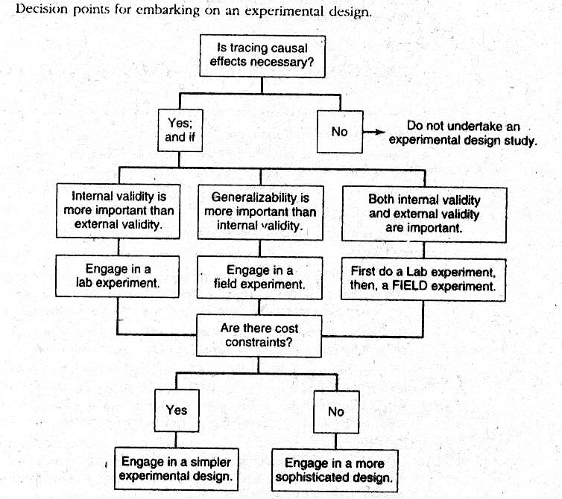
Managerial Implications

